Slide 1
Mark 11:12-25

Slide 2
¹² On the following day, when they came from Bethany, he was hungry. ¹³ And seeing in the distance a fig tree in leaf, he went to see if he could find anything on it. When he came to it, he found nothing but leaves, for it was not the season for figs. ¹⁴ And he said to it, “May no one ever eat fruit from you again.” And his disciples heard it.

Slide 3
¹⁵ And they came to Jerusalem. And he entered the temple and began to drive out those who sold and those who bought in the temple, and he overturned the tables of the money-changers and the seats of those who sold pigeons. ¹⁶ And he would not allow anyone to carry anything through the temple. ¹⁷ And he was teaching them and saying to them, “Is it not written, ‘My house shall be called a house of prayer for all the nations’? But you have made it a den of robbers.” ¹⁸ And the chief priests and the scribes heard it and were seeking a way to destroy him, for they feared him, because all the crowd was astonished at his teaching. ¹⁹ And when evening came they went out of the city.

Slide 4
²⁰ As they passed by in the morning, they saw the fig tree withered away to its roots. ²¹ And Peter remembered and said to him, “Rabbi, look! The fig tree that you cursed has withered.” ²² And Jesus answered them, “Have faith in God. ²³ Truly, I say to you, whoever says to this mountain, ‘Be taken up and thrown into the sea,’ and does not doubt in his heart, but believes that what he says will come to pass, it will be done for him. ²⁴ Therefore I tell you, whatever you ask in prayer, believe that you have received it, and it will be yours. ²⁵ And whenever you stand praying, forgive, if you have anything against anyone, so that your Father also who is in heaven may forgive you your trespasses.”

Slide 5
Palm Sunday – a celebration of the Rule and Reign of Jesus Christ
“Son of David” is used as a Messianic Title
A young donkey/mule, never been sat upon. A miracle to be ridden
Solomon rode David’s Mule. Demonstrated rightful claim to throne
Jesus the Son of God – His throne established forever
Coats to walk over – like Jehu – King to conquer Evil
Hosanna – Aramaic “O Save us!”
Jesus wasn’t the political leader they were hoping for in their Messiah
Jesus came as Judge; refiner; purifier; Sacrifice
Fig tree – a symbol of Israel. Jesus came, but no fruit for Him
The old Jewish Religious system is coming to an end.
Jesus cleared the temple of corruption – ready for a new thing
The Son of God came to His temple, but religion couldn’t handle Him. They killed Him.

Slide 6
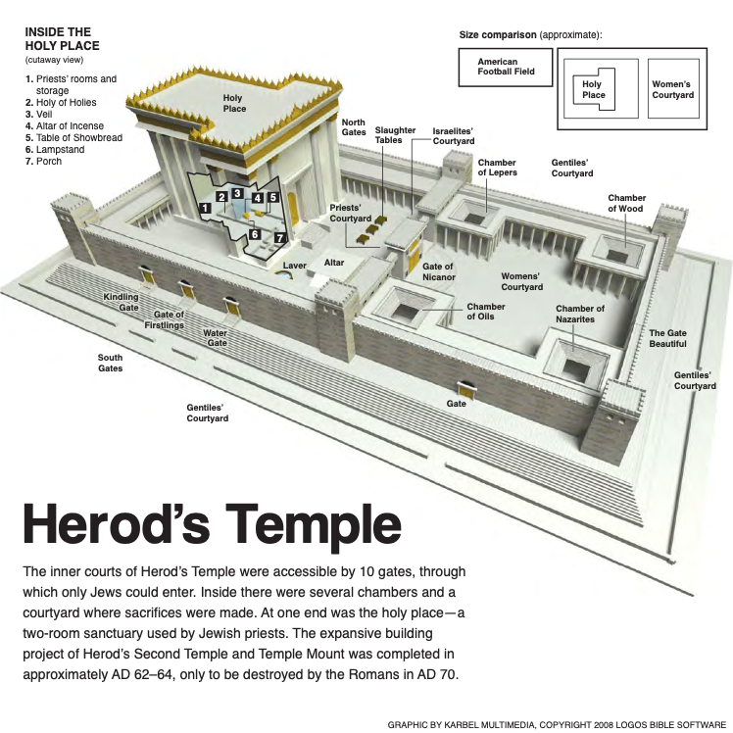
The Temple was like a religious tourist attraction.
Traders set up a market to sell their wares in the Court of the Gentiles
The Gentiles who came to worship and pray, could only get as close as here.

Slide 7
¹⁵ .... And he entered the temple and began to drive out those who sold and those who bought in the temple, and he overturned the tables of the money-changers and the seats of those who sold pigeons. ¹⁶ And he would not allow anyone to carry anything through the temple. ¹⁷ And he was teaching them and saying to them, “Is it not written, ‘My house shall be called a house of prayer for all the nations’? But you have made it a den of robbers.”
God’s vision for the Temple, was for it to be much bigger than just for Israel.
But the only place for those of another race, was turned into a place of greed and commerce.

Slide 8
7 The word that came to Jeremiah from the Lord: ² “Stand in the gate of the Lord’s house, and proclaim there this word, and say, Hear the word of the Lord, all you men of Judah who enter these gates to worship the Lord. ³ Thus says the Lord of hosts, the God of Israel: Amend your ways and your deeds, and I will let you dwell in this place. ⁴ Do not trust in these deceptive words: ‘This is the temple of the Lord, the temple of the Lord, the temple of the Lord.’

Slide 9
⁵ “For if you truly amend your ways and your deeds, if you truly execute justice one with another, ⁶ if you do not oppress the sojourner, the fatherless, or the widow, or shed innocent blood in this place, and if you do not go after other gods to your own harm, ⁷ then I will let you dwell in this place, in the land that I gave of old to your fathers forever.
⁸ “Behold, you trust in deceptive words to no avail. ⁹ Will you steal, murder, commit adultery, swear falsely, make offerings to Baal, and go after other gods that you have not known, ¹⁰ and then come and stand before me in this house, which is called by my name, and say, ‘We are delivered!’ — only to go on doing all these abominations? ¹¹ Has this house, which is called by my name, become a den of robbers in your eyes? Behold, I myself have seen it, declares the Lord.

Slide 10
¹² Go now to my place that was in Shiloh, where I made my name dwell at first, and see what I did to it because of the evil of my people Israel. ¹³ And now, because you have done all these things, declares the Lord, and when I spoke to you persistently you did not listen, and when I called you, you did not answer, ¹⁴ therefore I will do to the house that is called by my name, and in which you trust, and to the place that I gave to you and to your fathers, as I did to Shiloh. ¹⁵ And I will cast you out of my sight, as I cast out all your kinsmen, all the offspring of Ephraim.

Slide 11
God’s vision for the Temple – a house of prayer for all nations.
But the place for foreigners became a place of greed and commerce.
A den of robbers: Points to Jeremiah 7 - A warning against having a false sense of security that religious observance would make them right before God, when they continued in their injustice and wrong doing
Shiloh – 1st religious capital – destroyed
Jerusalem (Solomon’s temple) 2nd religious capital – destroyed
(Herod’s temple) 3rd religious capital – will be destroyed 70AD
“Jesus indirectly attacks them for allowing the temple to degenerate into a safe hiding place where people think that they find forgiveness and fellowship with God, no matter how they act on the outside. Jesus’ prophetic action and words attack a false trust in the efficacy of the temple sacrificial system.”
Garland David E.

Slide 12
God’s vision for the Temple – a house of prayer for all nations.
But the place for foreigners became a place of greed and commerce.
A den of robbers: Points to Jeremiah 7 - A warning against having a false sense of security that religious observance would make them right before God, when they continued in their injustice and wrong doing
Shiloh – 1st religious capital – destroyed
Jerusalem (Solomon’s temple) 2nd religious capital – destroyed
(Herod’s temple) 3rd religious capital – will be destroyed 70AD
A warning against fruitless religion / fruitless faith
Called to bear fruit of righteousness / fruit of the Spirit
God hates empty / fruitless religion & fruitless faith

Slide 13
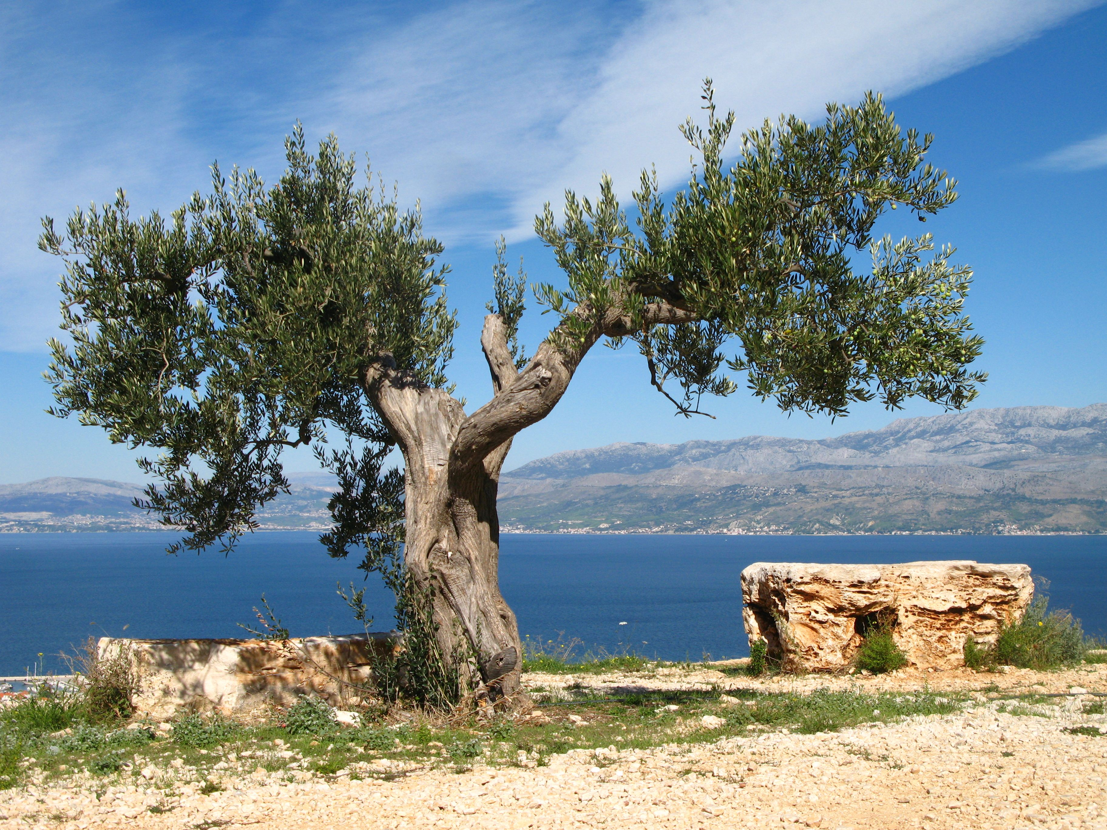
Natural olive branches: Israel who have faith in Jesus Christ (messianic Jews)
Wild branches grafted into the tree: Gentiles who have faith in Jesus
Branches broken off: Faithless Israel (those who reject Christ).
Many will be grafted back in when they turn to Jesus
Rootstock: The Patriarchs (Abraham, Isaac, Jacob, David) Culminating in Jesus Christ

Slide 14
God’s vision for the Temple – a house of prayer for all nations.
But the place for foreigners became a place of greed and commerce.
A den of robbers: Points to Jeremiah 7 - A warning against having a false sense of security that religious observance would make them right before God, when they continued in their injustice and wrong doing
Shiloh – 1st religious capital – destroyed
Jerusalem (Solomon’s temple) 2nd religious capital – destroyed
(Herod’s temple) 3rd religious capital – will be destroyed 70AD
A warning against fruitless religion / fruitless faith
Called to bear fruit of righteousness / fruit of the Spirit
God hates empty / fruitless religion & fruitless faith
Faith without works is dead
Being a disciple of Jesus, is a life of fruitful faith

